Slide 1
HDFS BASICS

Slide 2
HDFS : Hadoop distributed file system
(BASIC HDFS)
Pre-requisites
Basic understanding of what file system means
Practical working knowledge of UNIX file system basics

Slide 3
Agenda
Architecture of HDFS
How does HDFS store the file internally
Failure handling and recovery mechanism
Rack awareness
Role of name node and secondary name node
When to use HDFS and when not to use it

Slide 4
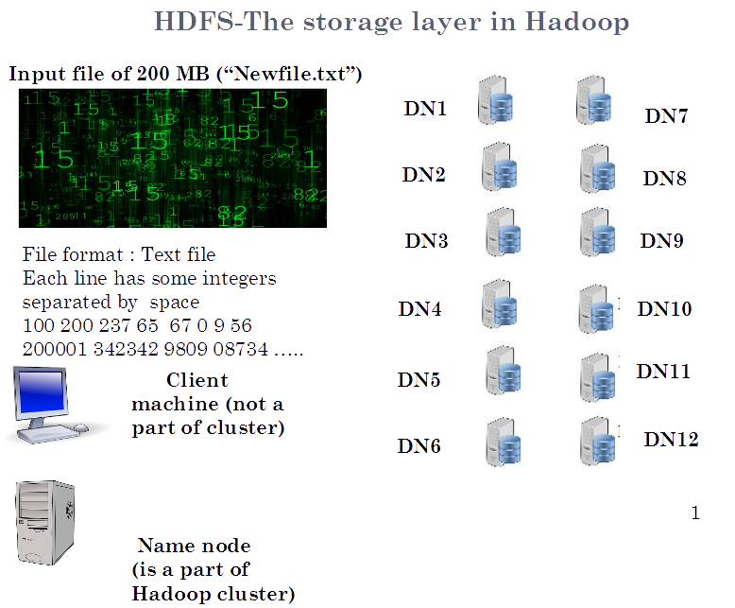
HDFS – The Storage Layer in Hadoop

Slide 5
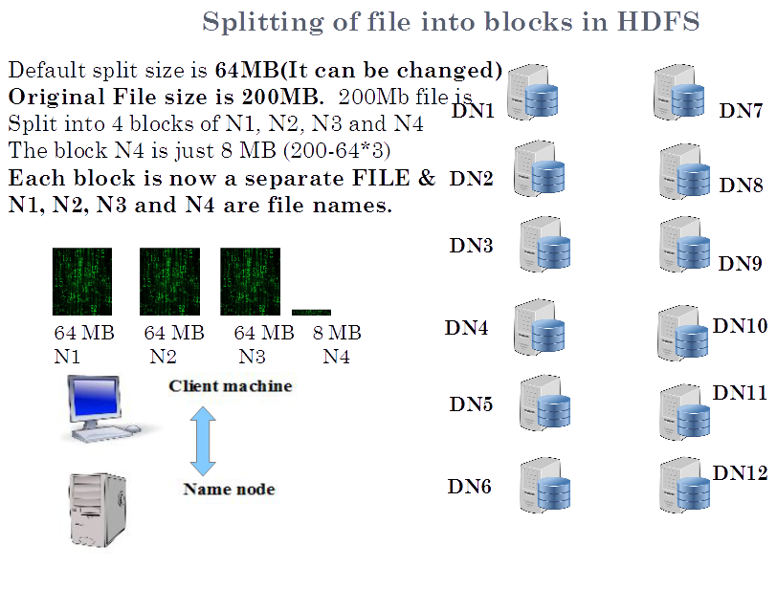
Splitting of file into blocks in HDFS

Slide 6
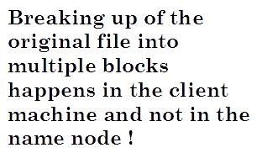
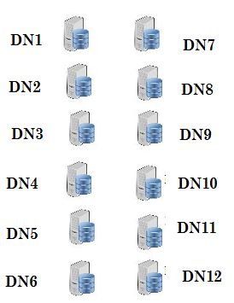


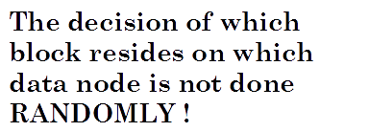
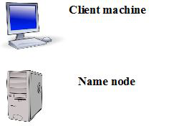

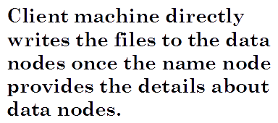
File Storage in HDFS

Slide 7
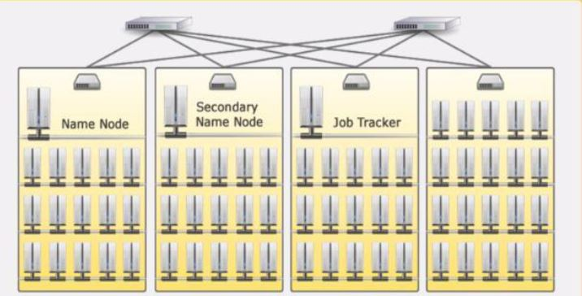






Hadoop cluster deployed in a production environment into multiple racks
Multilayer switches/routers interconnect the switches on each rack

Slide 8
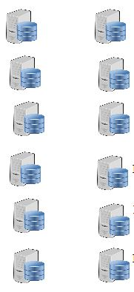


Failure of a data node
Q)What happens in the event of a data node
Failure ? (eg : DN 10 fails)
A)Data saved on that node will be lost
To avoid loss of data, copies of the
Data blocks on data node is stored on multiple data nodes. This is called data replication.
DN7
DN1
DN8
DN2
DN9
DN3
DN4
DN10
DN5
DN11
DN6
DN12

Slide 9
Replication of data blocks
How many copies of each block to save?
Its decided by REPLICATION FACTOR (by default its 3, i.e. every block of data on each data node is saved on 2 more machines so that there is total 3 copies of the same data block on different machines)
This replication factor can be set on per file basis while the file is being written to HDFS for the first time.

Slide 10
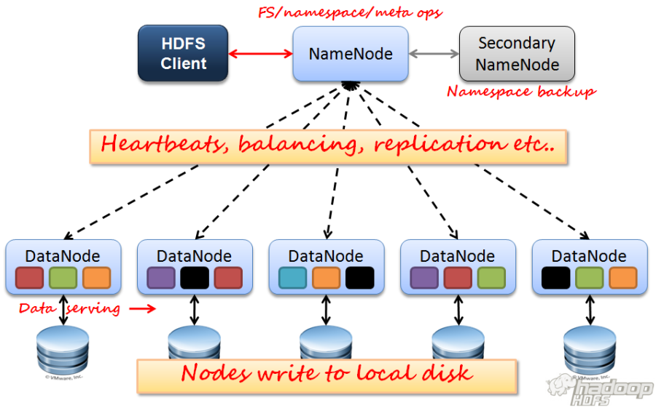


Design and Architecture Overview

Slide 11

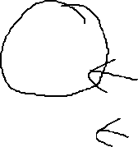

Data replication on failure and failed node recovers
Replication factor =2
DN10 fails
Replication factor for block N2 is now 1 !
DN7
DN1
DN8
DN2
DN9
DN3
DN4
DN10
DN5
DN11
DN6
DN12

Slide 12
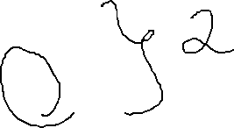
Data replication on failure and failed node recovers Pt2
Replication factor =2
DN10 fails
The data on the failed node would be copied
to some other node in the cluster
automatically. In this case its copied to
DN12 from its nearest neighbour DN11
DN7
DN1
DN8
DN2
DN9
DN3
DN4
DN10
DN5
DN11
DN6
DN12

Slide 13

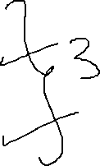
DN10 is up again after some time …
Replication factor = 3 for block N2
HDFS will delete one extra copy of N2 from
any of the 3 nodes (DN10, DN11 or DN12)
This ensures that the replication count is
maintained all the time
DN7
DN1
DN8
DN2
DN9
DN3
DN4
DN10
DN5
DN11
DN6
DN12

Slide 14
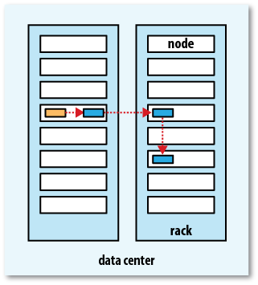
Replica Placement Strategy
Q. How does namenode choose which datanodes to store replicas on?
Replica Placements are rack aware. Namenode uses the network location when determining where to place block replicas.
Tradeoff: Reliability v/s read/write bandwidth e.g.
  If all replica is on single node - lowest write bandwidth but no redundancy if nodes fails
  If replica is off-rack - real redundancy but high read bandwidth (more time)
  If replica is off datacenter – best redundancy at the cost of huge bandwidth
Hadoop’s default strategy:
  1st replica on same node as client
  2nd replica on off rack any random node
  3rd replica is same rack as 2nd but other node
Clients always read from the nearest node
Once the replica locations is chosen a
pipeline is built taking network topology
into account

Slide 15
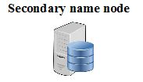

Name node & secondary name node in Hadoop 1.0
I shall back up the data of
name node
BEWARE !
I do not work in HOT STANDBY
mode in the event of name node
failure…..
I know where
the file blocks are..
In Hadoop 1.0, there is no active standby secondary name node.
(HA : Highly available is another term used for HOT/ACTIVE STANDBY )
If the name node fails, the entire cluster goes down ! We need to manually restart
The name node and the contents of the secondary name node has to be copied to it.

Slide 16
When to/not to use HDFS?
HDFS is Good for…
Storing large files
Terabytes, Petabytes, etc.
millions rather billions of files (less number of large files)
Each file typically 100MB or more
Streaming data
WORM - write once read many times patterns
Optimized for batch/streaming reads rather than random reads
Append operation added to Hadoop 0.21
Cheap commodity hardware
HDFS is not so Good for…
Large amount of small files
Better for less no of large files instead of more small files
Low latency reads
Many writes: write once, no random writes, append mode write at end of file

Slide 17
Summary
Introduction to HDFS
Replication factor
Rack awareness
When not to use HDFS

